Slide 1
Smart Waste Management, Disposal and Sanitization Monitoring AI System
CSE7101- Capstone Project
Review-2
Batch Number: PSCS_424
NAME | ROLL_NO
JOYSON C H | 20221CSE0531
RAMYA S V | 20221CSE0550
TEJAS N B | 20221CSE0560
Under the Supervision of,
Ms. Shet Reshma Prakash
Assistant Professor
School of Computer Science and Engineering
Presidency University
Name of the Program: B.Tech C.S.E
Name of the HoD: Dr. Asif Mohammed
Name of the Program Project Coordinator: Dr. Jayavadivel Ravi
Name of the School Project Coordinators: Dr. Sampath A K , Dr. Geetha A

Slide 2
DETAILS
Organization:
Category: Software
Problem Description:
Urban areas and campuses struggle with ineffective waste segregation and poor sanitation
monitoring. Manual processes lead to delays, inefficiency, and environmental pollution . Lack of
real-time tracking hampers timely waste collection and disposal . Public participation in proper waste
management is minimal . A smart, technology-driven solution is needed to ensure sustainable and
efficient waste handling.

Slide 3
Problem Statement
  Rapid urbanization and population growth are causing excessive waste generation, leading to environmental pollution and health risks.
Improper segregation of biodegradable, recyclable, and hazardous waste results in contamination and resource wastage.
Manual collection and disposal processes are inefficient, unhygienic, and prone to errors, with frequent delays and missed pickups.
Lack of proper sanitization logging after waste disposal reduces accountability and increases disease risks.
Minimal public awareness and absence of real-time digital platforms prevent active citizen participation in sustainable waste management.

Slide 4
OBJECTIVE
To design a website-based platform integrating smart waste segregation, disposal, and sanitization systems.
To implement an AI-powered waste classification system for identifying organic, recyclable, and hazardous waste.
To provide educational resources on proper waste management and sanitation practices.
To enable smart disposal tracking for monitoring waste handling efficiency.
To create a community idea-sharing hub for eco-friendly innovations.

Slide 5
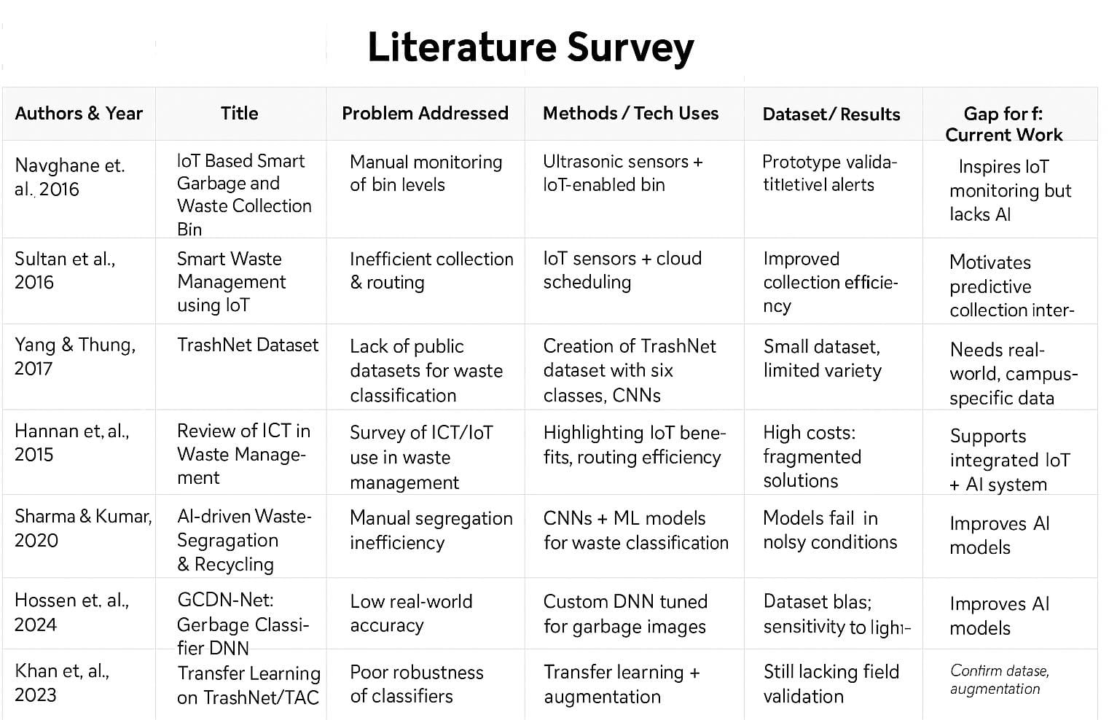
Literature Survey(Overview)

Slide 6
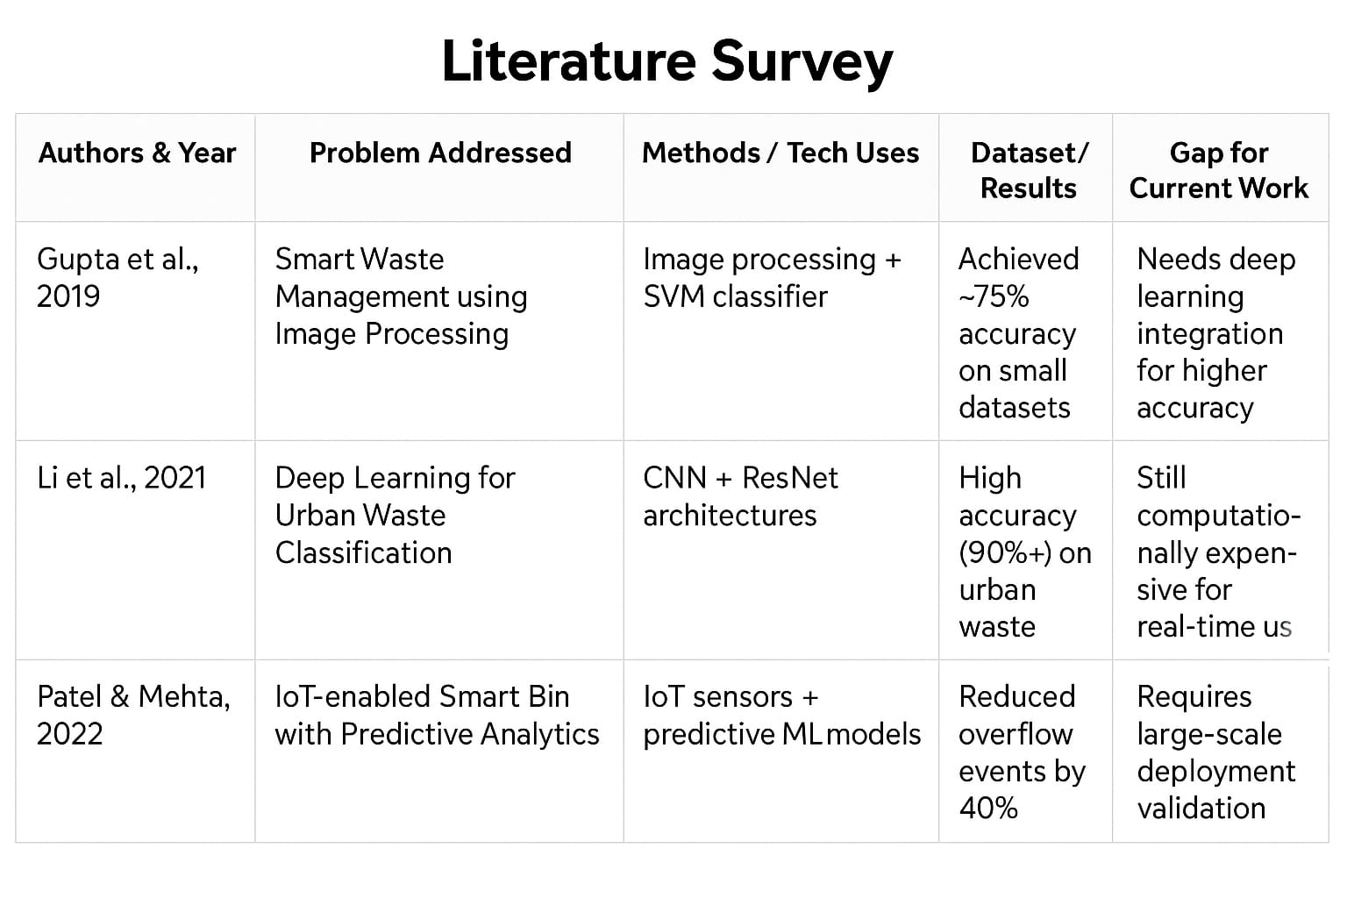
Literature Survey(Overview)

Slide 7
Proposed Method & Feasibility Study
Proposed Method & Feasibility Study
AI Classification: Detects organic, recyclable, and hazardous waste.
IoT Smart Bins: Sensors track bin level and sanitation.
Prediction: ML models forecast waste and plan collection.
Sanitization Log: Records cleaning activity with proof.
User Portal: Dashboards for admin, workers, and citizens.
Feasibility:
Technology: Uses proven AI and IoT tools.
Cost: Low-cost sensors and free/open-source software.
Resources: Easy to build with university labs and team skills.

Slide 8
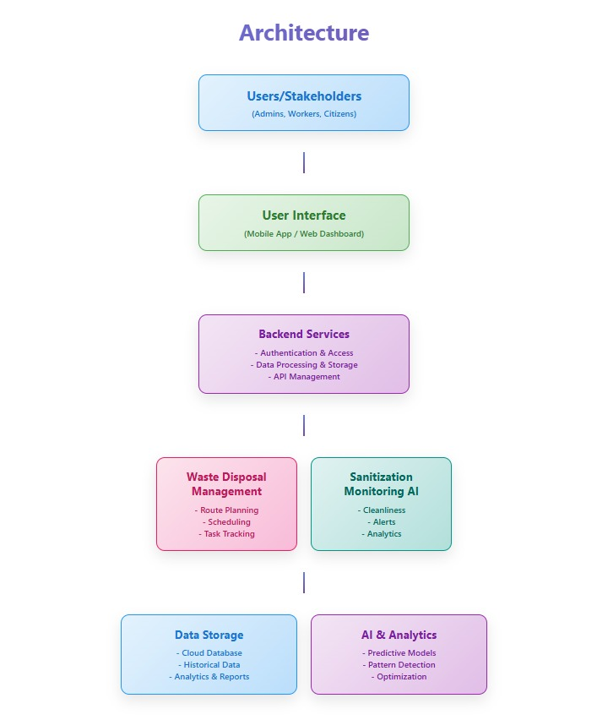
Architecture Diagram(rough)

Slide 9
Background and Related Work
Rapid urbanization increases waste generation, while manual collection
methods cause inefficiency, pollution, and health hazards.
AI-based waste classification (CNNs, Transfer Learning) improves segregation accuracy but struggles
with hazardous waste and real-world variability
IoT smart bins (ultrasonic, gas, fill-level sensors) enable real-time monitoring but face power,
connectivity, and maintenance challenges.
Predictive analytics (RF, XGBoost, LSTM) and stochastic routing models reduce costs and emissions,
yet depend on reliable sensor data.
Research gaps remain in post-disposal sanitization logging,
large-scale deployment, and integrated citizen-centric platforms.

Slide 10
Analysis of Problem Statement
Technology Stack – Components
Frontend: HTML5, CSS3, JavaScript, Bootstrap/Tailwind CSS (responsive UI).
Backend: Node.js, Express.js (REST APIs, logic handling).
AI/ML: Python (waste classification, predictive analytics, missed-collection detection).
Database: MySQL (users, waste logs, sanitization records).
Integrations:
  Google Maps API → Geo-tagging bins, mapping collection routes.
  Twilio/SMTP → SMS & email alerts.
Hosting: GitHub Pages / Netlify (frontend).

Slide 11
Analysis of Problem Statement
Software & Hardware Requirements
Operating System: Windows / Linux
Development Tools: VS Code, Node.js runtime, Python IDE (Jupyter)
Database: MySQL server for storage of user, waste, and sanitization records
APIs/Services: Google Maps API (geo-tagging)
Version Control & Hosting: GitHub, Netlify
Server Deployment: Cloud instance (2–4 cores, 8GB RAM, 100GB storage)
End User Devices: PC/Laptop with modern browser, Smartphone (citizen app)

Slide 12
Github Link
https://github.com/Ramya123202/Clean-and-Green-technology.git

Slide 13
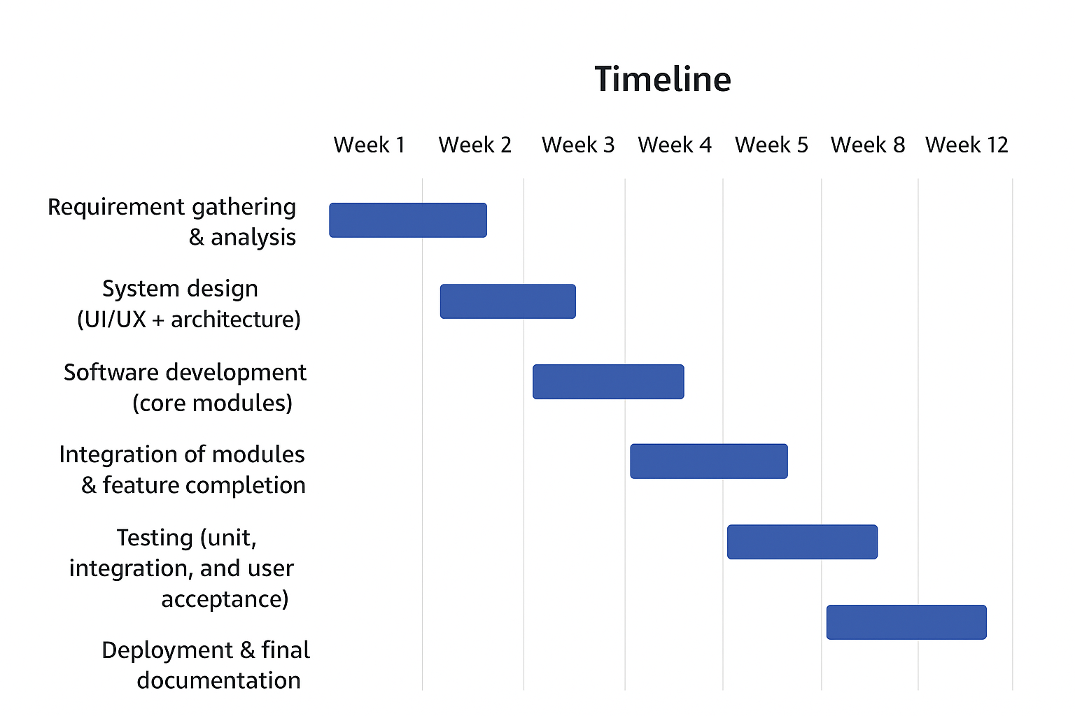
Timeline of the Project

Slide 14
References (IEEE Paper format)
S. S. Navghane, M. S. Killedar, and V. M. Rohokale, "IoT based smart garbage and waste collection bin," IJARECE, vol. 5, no. 5, May 2016.
A. F. M. Sultan, M. R. I. Faruque, and M. A. Rashid, "Smart waste management system using IoT," Proc. 3rd Int. Conf. Electrical Engineering and ICT, Dhaka, 2016.
N. Sharma and A. Kumar, "AI-driven waste segregation and recycling management," IEEE Access, 2020.
M. A. Hannan, et al., "A review of smart waste management: Issues, challenges, and opportunities," IEEE Access, 2018.
K. R. S. Kumar and P. Shanthini, "Waste management using IoT and machine learning approaches," Journal of Environmental Research and Development, 2021.

Slide 15


